Slide 1
Analysis on PBC Data
Stat 271 fall 2015
Gurinder Singh
Prash Medirattaa Kuldeep Kaur

Slide 2

Topics covered
Study
Data
Collinearity
Analysis Linear Regression
ANOVA
Logistic Regression
Survival Time Analysis
Conclusion & Future References
Questions

Slide 3
Primary Biliary Cirrhosis (PBC)
Primary biliary cirrhosis (PBC) is a chronic liver disease.
PBC is a rare but fatal chronic liver disease of unknown cause
with a prevalence of about 50-cases-per-million population.
It generally strikes women between the ages of 40 and 60, but it has been diagnosed outside of this age range as well as in men.
PBC eventually results in scarring of the liver.
There is currently no known cure for PBC.
Liver transplantation is now a common treatment.

Slide 4
Mayo Clinical Study
The Mayo Clinic data set is one of the last study of the natural history of PBC in patients.
Clinical trial in primary biliary cirrhosis (PBC) of the liver conducted between 1974 and 1984 by Mayo clinic.
For that analysis, disease and survival status as of July, 1986, readings were recorded for as many patients as possible.
A total of 424 PBC patients , Double blind experiment

Slide 5
Data Information
Quantitative (10) | Qualitative (7)
Age | Two levels Categorical Variables
Bilirubin
Cholesterol | Treatment
Albumin | Gender
Urine copper | Ascites
Alkaline phosphatase | Hepatomegaly
SGOT | Spiders
Triglycerides | More than two level Categorical Variables
Platelet count | Edema – 3 levels
Prothrombin time | Histologic stage -4levels
Methodologies used | Response Variable
Linear Regression | Survival Time
ANOVA | Survival Time
Logistic Regression | Censoring
Survival Analysis | Survival Time
418 observations, 19 variables

Slide 6
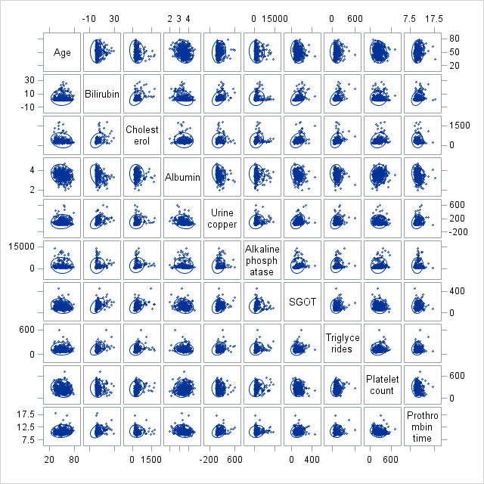
Scatterplot Plot Matrix
≠

Slide 7
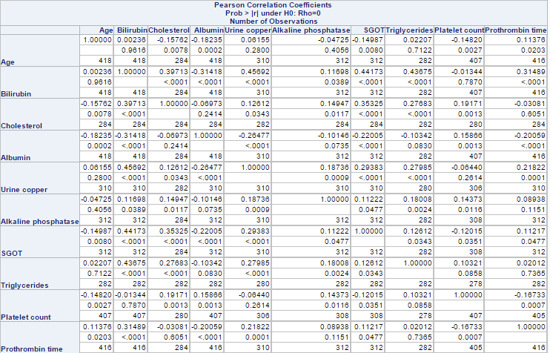
Correlation Matrix

Slide 8
Multicollinearity
Goal: To check collinearity between explanatory variables.
Max r value : Urine Copper & Bilirubin = 0.45692
Min r value : Prothrombin Time & Platelet Count = 0.00007
We did not consider PCA since significant correlation didn’t exist among our explanatory variables.
Decided to keep all explanatory variables for our analysis

Slide 9
Linear Regression
Goal : To develop a model to describe the relationship between multiple explanatory variables and survival time while keeping treatment in the model even if it is not significant.
Technique used : Manual selection
Indicator variables: Edema (0 = reference)
Histologic Stage (1 = reference)
Model: y = β₁x₁+ β₂x₂ + β₃x₃ + β₄x₄ + β₅x₅+ β₆x₆ + ɛ
Where y = Survival Time
x₁ =Treatment (1 = D-penicillamine, 0 = Placebo)
x₂ = bilirubin
x₃ = Albumin
x₄=Urine Copper
x₅= Alkaline Phosphatase
x₆= Histologic Stage 4
ɛ iidN(0,ơ²)

Slide 10
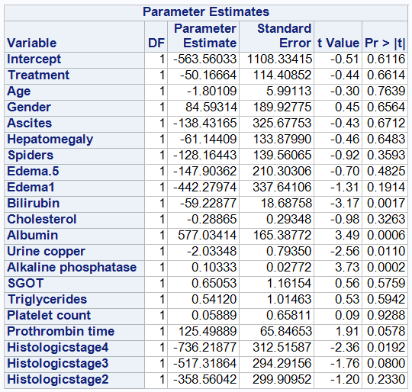
Full Model

Slide 11
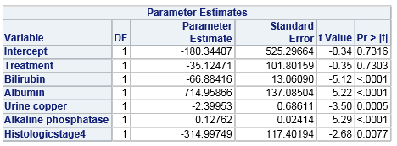
Fitted Model: ŷ = -180.34407 - 35.12471x₁ - 66.88416x₂+ 714.95866x₃ - 2.39953x₄ + 0.12762x₅ - 314.99749x₆
All the explanatory variables have a significant effect on the survival time, except for treatment which has a p-value = 0.7303.

Slide 12
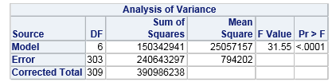
Global Hypothesis testing
H_{o}: β₁ = β₂ = β₃= β₄ = β₅= β₆ =0
H_{a}: Regression model is overall significant
The p-value (<0.001) is small, therefore the regression model is overall significant.

Slide 13
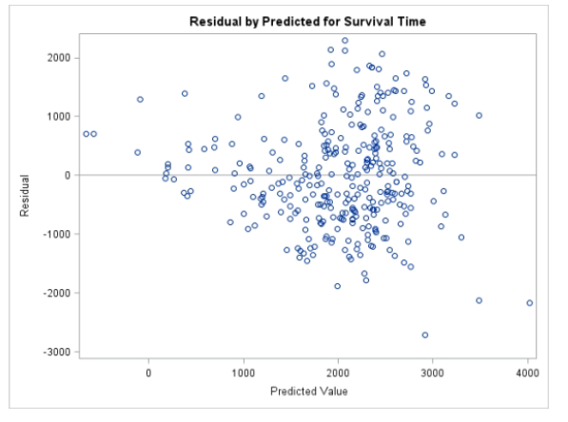
Assumptions
Constancy of variance
By looking at the residuals vs. predicted value graph, we conclude that the constancy of variance is obtained.

Slide 14
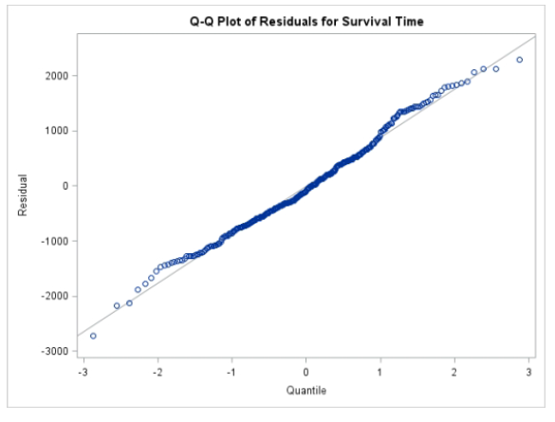
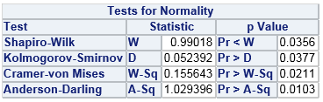
Normality test for residuals
By looking at the Q-Q plot graph, we conclude that the residuals follow a normal distribution with a few outliers.
H_{o}: Residuals are normally distributed
H_{a}: Residuals are not normally distributed
At α = 0.01 we fail to reject H_{o} and at α = 0.05, all the 4 tests have a p-value < α, so we reject Ho.

Slide 15
ANOVA
Goal: To select the significant factors which effect survival time.
Technique used : Manual selection
Model: y_{ijklm}= µ + α_{i} + β_{j} + ɼ_{k} + ɳ_{l} + ƥ_{m} + ƛ_{n} + ɛ_{ijklm}
Where y_{ijklm} = Survival Time
α_{i} = effect of Bilirubin
β_{j} = effect of Albumin
ɼ_{k} = effect of Urine Copper
ɳ_{l} = effect of Alkaline Phosphatase
ƥ_{m} = effect if m-th level of Treatment m=1, 2
ƛ_{n} = effect of n-th level of Histologic Stage n=1, 2, 3, 4
ɛ_{ijklm} iidN(0,ơ²)

Slide 16
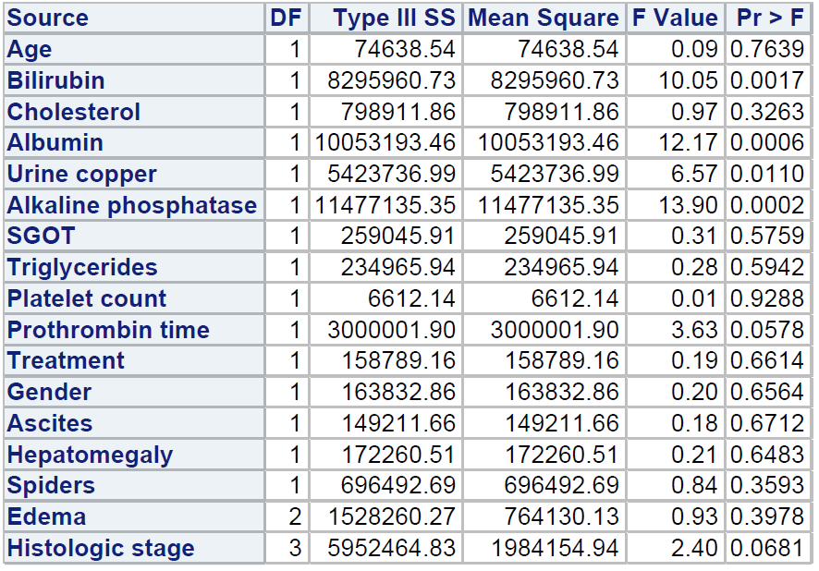
Full Model

Slide 17
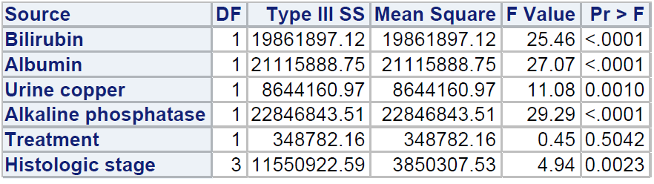
Significant Factors
All the factors have a significant effect on survival time, except for treatment which has a p-value = 0.5042.

Slide 18
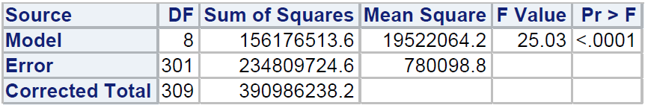
Hypothesis testing
H_{o}: α_{i} = β_{j} = ɼ_{k} = ɳ_{l} = ƥ_{m} = ƛ_{n} = 0
H_{a}: ANOVA model is overall significant
The p-value (< 0.001) is small, therefore ANOVA model is overall significant.

Slide 19
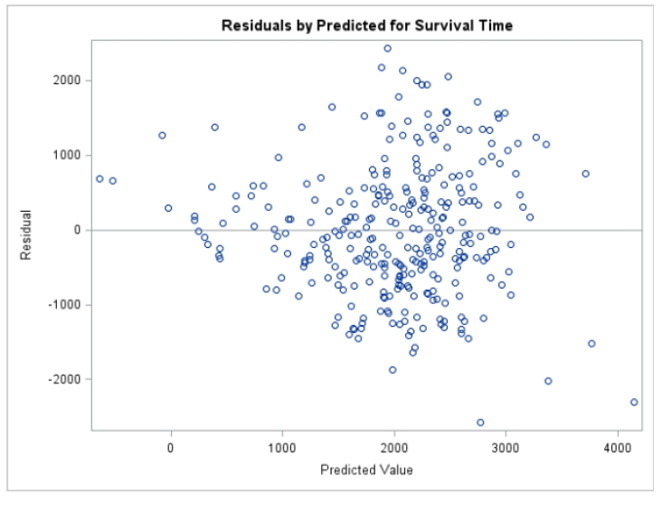
Assumptions
Constancy of variance
By looking at the residuals vs. predicted value graph, we conclude that the constancy of variance is obtained.

Slide 20
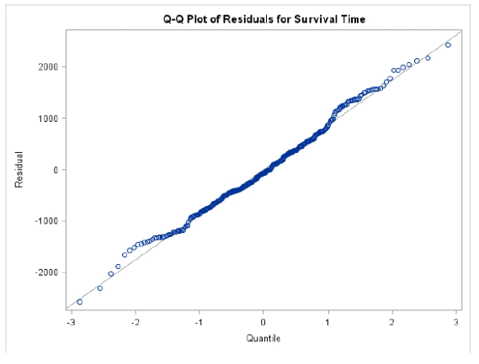
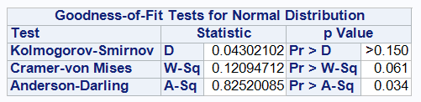
Normality test for residuals
By looking at the Q-Q plot graph, we conclude that the residuals follow a normal distribution with a few outliers
H_{o}: Residuals are normally distributed
H_{a}: Residuals are not normally distributed
At α = 0.01 we fail to reject Ho.

Slide 21
Logistic Regression
Aim: To model the probability of death and correlate risk of death with other explanatory variables.
Indicator variables: Edema (0 = reference)
Histologic Stage (1 = reference)
Model: logit(π) = β₁x₁+ β₂x₂ + β₃x₃ + β₄x₄ + β₅x₅+ β₆x₆
logit(π) = log(π/(1-π))
Where p(y=1)= death = 1 (censoring = 0)
x₁ = Age
x₂ = Bilirubin
x₃ = Urine Copper
x₄ = Alkaline Phosphatase
x₅ = Prothrombin Time

Slide 22
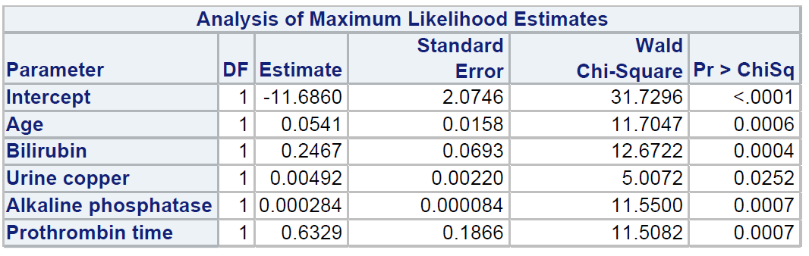
Fitted Model: logit(π) = -11.6860 + 0.0541x₁ + 0.2467x₂ + 0.00492x₃ + 0.000284x₄ + 0.6329x₅
Significant explanatory variables that correlate the risk of death.

Slide 23
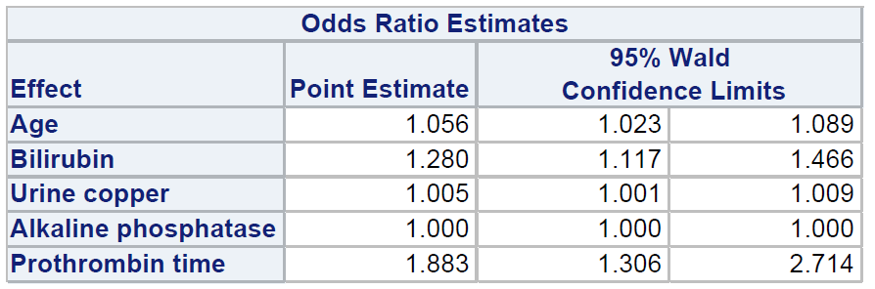
Interpretations
When age is increased by 1 year, the odds of death is multiplied by 1.056 while all the other explanatory variables are fixed.
We are 95% confident that with 1 year increase in age, the odds if death will be multiplied by between 1.023 and 1.089.

Slide 24
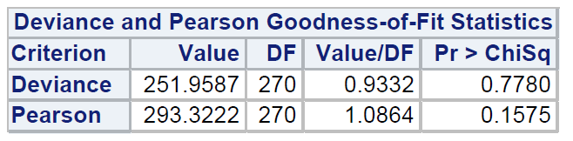
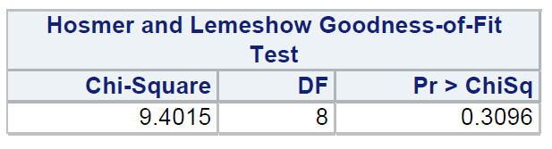
Goodness-of-fit testing
H_{o}: The logistic regression model provides an adequate fit to the data
H_{a}: The logistic regression model does not provides an adequate fit to the data
At α = 1% the Deviance and Pearson Goodness of fit test support H_{o}. Therefore, the logistic regression model provides an adequate fit to the data. The Hosmer Lemeshow test also supports H_{o}.

Slide 25
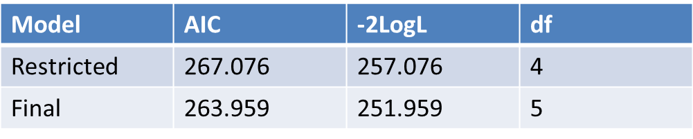
Deviance test
Test: Is urine copper significant?
H_{o}: Restricted Model
H_{a}: Full Model
G = 257.076 – 251.959= 5.117
df=1
P(Chi-square(df=1) > 5.117) = .0236
Urine copper is significant at α = 5%
Urine copper is not significant at α = 1%

Slide 26
Survival Time
Goal: To model the survival time and identify the factors that are significant to hazard of death.
Indicator variables: Edema (0 = reference)
Histologic Stage (1 = reference)
Comparing survival functions:
S₁(t) = survival function for D-penicillamine
S₂(t) = survival function for placebo
H_{o}: S₁(t) = S₂(t)
H_{a}: S₁(t) ≠ S₂(t)

Slide 27
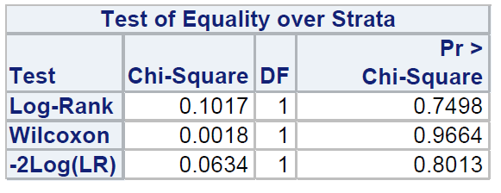
Hypothesis Testing
Log-Rank and Wilcoxon tests, both have large p-values (.7498, .9664) so we cannot reject H_{o}. We conclude that there is no significant difference between the survival functions for patients given D-penicillamine and the survival function for patients given placebo.

Slide 28
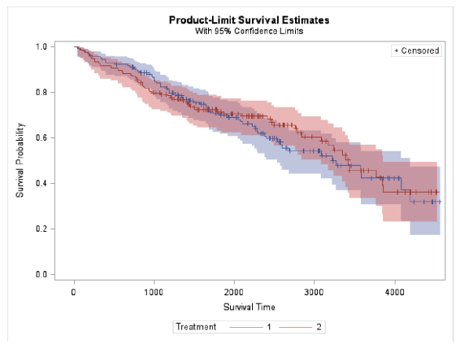
There is a lot of overlap of the survival functions. D-penicillamine has a higher survival function until about 1700 days. After 1700 days the survival function for Placebo is higher until time 3200.

Slide 29
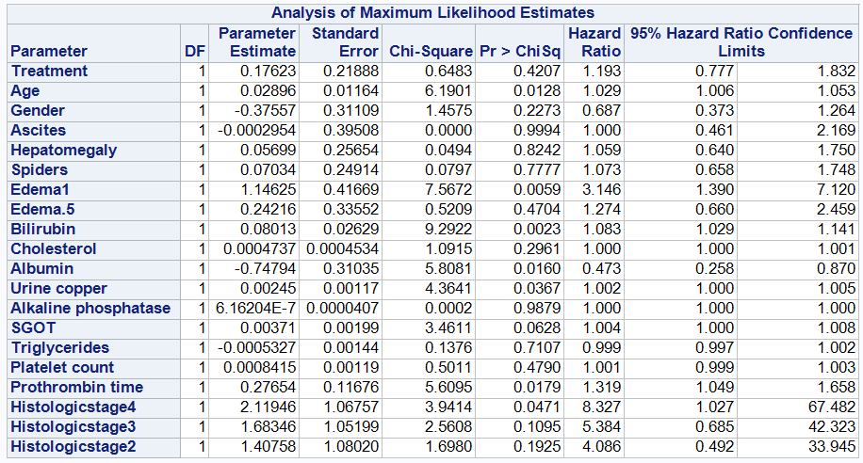
Full Model

Slide 30
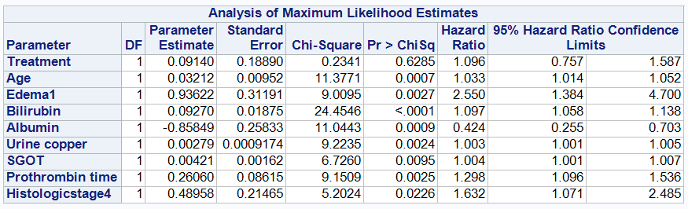
Hazard ratio
When the age is increased by 1 year, the hazard function of survival time is multiplied by 1.033 while all the other explanatory variables are fixed.
We are 95% confident, when the age is increased by 1 year the hazard function of survival time is multiplied by between 1.014 and 1.052.

Slide 31
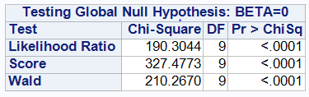
Propotional hazard model
Global hypothesis test
H_{o} : The overall fitted model is not significant
H_{a} : The overall fitted model is significant
The small p-value(<.001) for Likelihood Ratio, Score and Wald’s test support H_{a}. Therefore, it can be concluded that the overall fitted model is significant.

Slide 32
Conclusion
All four methods concluded that treatment does not have any effect on PBC patients.
The older the PBC patient, the higher the chance of dying.
Future: Study can be used for predicting survival time for PBC patients using other explanatory variables.

Slide 33
THANK YOU !!
QUESTIONS
☺

